Slide 1
Comprehensive Digital Marketing Project Work

Slide 2

Part 1: Brand study, Competitor Analysis & Buyer’s/Audience’s Persona
COMPANY/TOPIC for project: WIPRO
Research Brand Identity: Study the brand's mission, values, vision, and unique selling propositions (USP)
BRAND COLOURS:
Blue , Green , Red
Logo:
Mission/Values:
"Our mission is to help our clients achieve their business objectives through a combination of process excellence, quality frameworks and service delivery innovation.“
According to Wipro's website, the company's vision is to "be a globally respected corporation that provides best-in-class products, solutions and services, and to be the most trusted partner for its
Wipro provides complete range of IT services to the organization
USP:

Slide 3
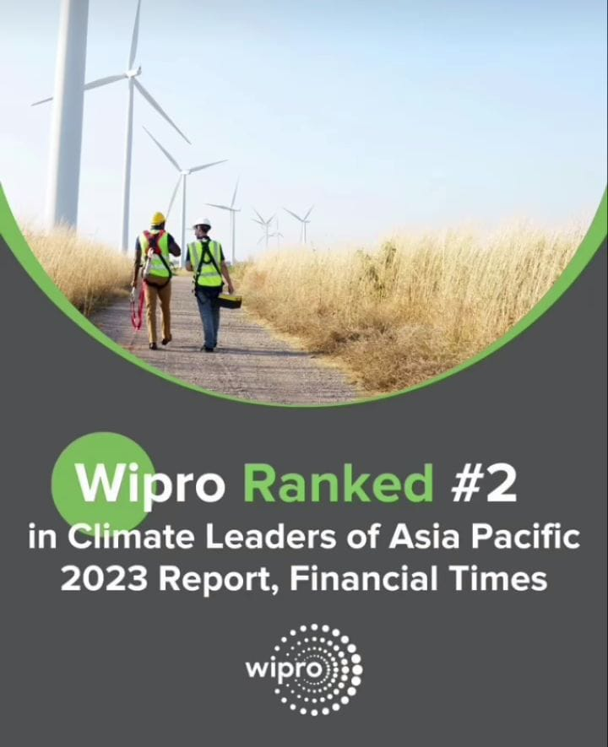

Part 1: Brand study, Competitor Analysis & Buyer’s/Audience’s Persona
COMPANY/TOPIC for project: WIPRO
Brand Messaging:
Information about their electrical, Soaps, Detergent Products
https://www.instagram.com/p/Ct9Mbw9L_WY/?igshid=MzRlODBiNWFlZA==
https://www.instagram.com/reel/Ct_rVxTAxnV/?igshid=MzRlODBiNWFlZA==
Brand's tagline:
'Applying Thought'. 'Powered by intellect.

Slide 4
Part 1: Brand study, Competitor Analysis & Buyer’s/Audience’s Persona
Competitor Analysis: Select three competitors operating in the same industry or niche as the chosen brand, examine their USPs and online communication.
Competitor 1: ICIMS
https://www.icims.com/
USP:
Comprehensive Talent Acquisition Suite, Scalability, User-friendly Interface,
Customization and Flexibility.
Online Communication:
Provided Toll Free Number, Tutorials, User Generated Content
Competitor 2:TCS
https://www.tcs.com/
USP:
Experience and Expertise , Global Presence , Clientele, Innovation and R&D
Online Communication:
Mail , Toll Free Number.

Slide 5
Competitor 3: INFOSYS
https://www.infosys.com/
USP:
Global Presence , Client-Centric Approach , Innovation and Research
Online Communication:
Through some Digital Arts, Experience sharing interviews

Slide 6
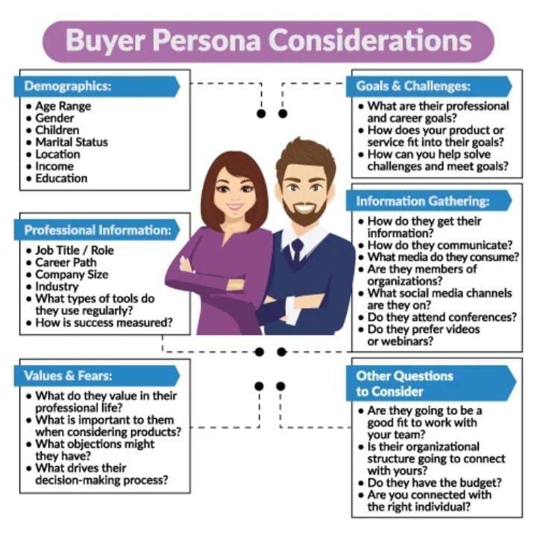
Part 1: Brand study, Competitor Analysis & Buyer’s/Audience’s Persona
Buyer's/Audience's Persona: Clearly define the target audience for the chosen brand. Consider demographics, psychographics, behaviors, and interests.
Age Range: No Age Limit (age limit may be vary because lots of products are there)
Gender: Any Gender
Children: yes
Marital Status: Married/Unmarried
Location: World Wide
Income: Above 2,00,000
Education: Educated/Non-Educated
WHAT DO THEY VALUE IN THEIR PROFESSIONAL LIFE?- Appearance,
WHAT IS IMPORTANT TO THEM WHEN CONSIDERING PRODUCTS?- Market research, Establish proof of concept, Finding the right factory, Build a unique brand identity, Choose the right sales channels.
WHAT OBJECTS MIGHT THEY HAVE?- bringing together consulting, design, engineering, implementation, and operations.

Slide 7
Part 2: SEO & Keyword Research
SEO Audit: Do an SEO audit of the brands website
Keyword Research: Define Research Objectives, Brainstorm Seed Keywords, Utilize Keyword Research Tools (SEMrush or Moz Keyword Explorer),Analyze Competitor Keywords, Long-tail Keyword Exploration (specific, longer phrases) that align with the research objectives and have lower competition but higher conversion potential.
On page Optimization: Meta Tag optimization & content optimization
Reflect on the process of conducting keyword research and the SEO recommendations provided.
Document the challenges faced during the research and analysis phase, as well as the key insights gained from the keyword research process.

Slide 8
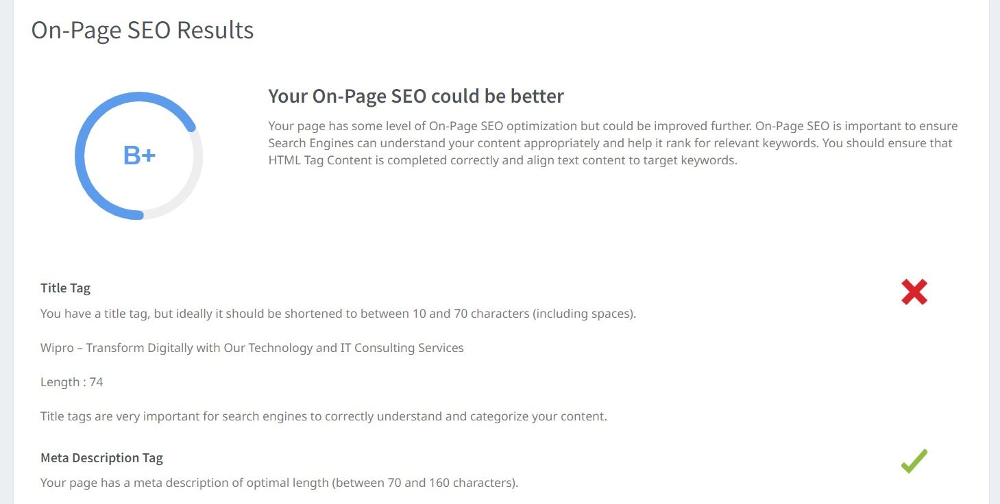
SEO Audit: Do an SEO audit of the brands website

Slide 9
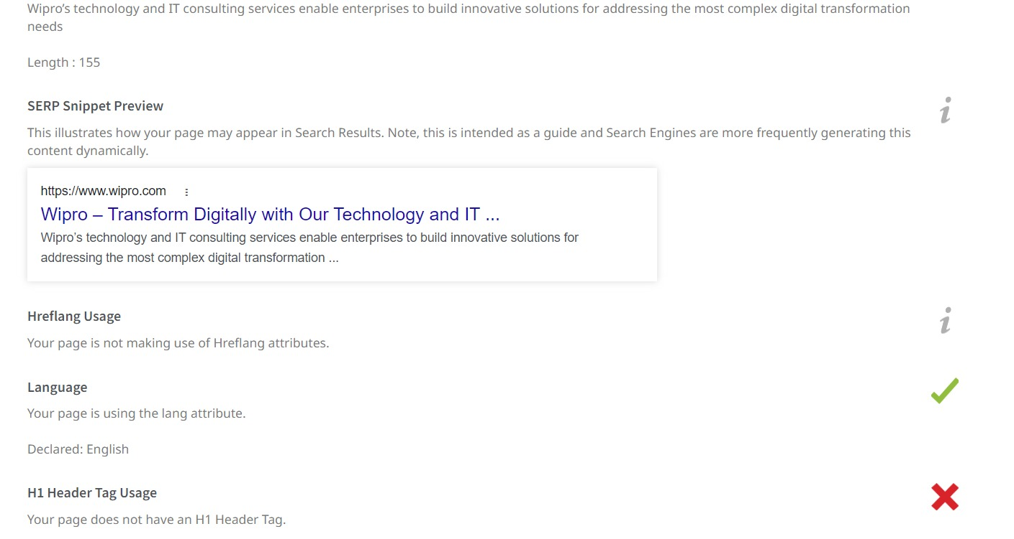

Slide 10
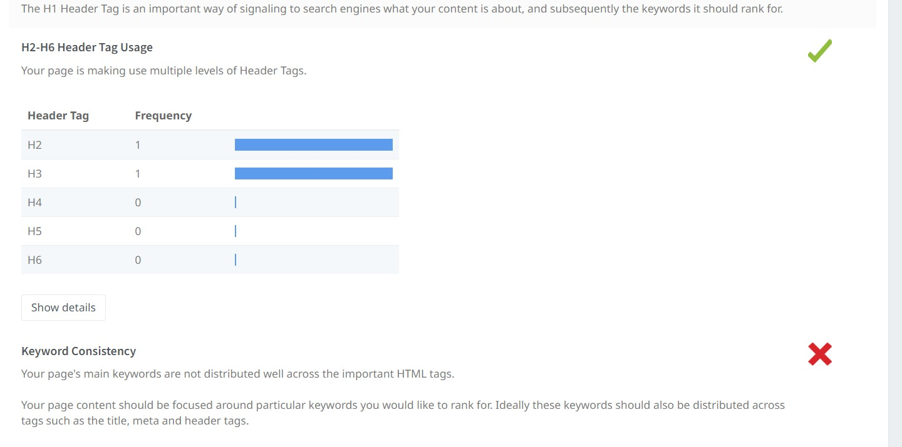

Slide 11
Liquid
Keyword | Avg. monthly searches | Competition
liquid detergent | 50000 | High
washing liquid | 5000 | High
clothes liquid | 50 | High
META TITLE
Explore Liquids like Liquid Detergent ,Washing Liquid , Clothes Liquid |  | 69
META DISCRIPTION
Buy Quality Liquids like Liquid Detergent , Washing Liquid , Clothes Liquid at our WIPRO Website |  | 96
Soaps
Keyword | Avg. monthly searches | Competition
soap | 50000 | Medium
hand wash soap | 500 | High
liquid laundry soap | 50 | High
META TITLE
Explore Soaps like Soap , Hand Wash Soap, Liquid Laundry Soap |  | 58
META DISCRIPTION
Buy Quality Soaps like Soap , Hand Wash Soap , Liquid Laundry Soap at our WIPRO Website |  | 88

Slide 12
Sanitizers
Keyword | Avg. monthly searches | Competition
hand sanitizer | 5000 | Medium
sanitizer gel | 500 | High
alcohol sanitizer | 500 | Medium
META TITLE
Explore Sanitizers like Hand Sanitizer, Sanitizer Gel, Alcohol Sanitizer |  | 70
META DISCRIPTION
Buy Quality Sanitizers like Hand Sanitizers , Sanitizer Gels, Alcohol Sanitizers at our WIPRO Website |  | 99
Lotion
Keyword | Avg. monthly searches | Competition
body lotion | 50000 | High
moisture lotion | 5000 | High
luxury lotion | 50 | High
META TITLE
Explore Lotions like Body Lotion ,Moisture Lotion, Luxury Lotion |  | 61
META DISCRIPTION
Buy Quality Lotions like Body Lotion , Moisture Lotion , Luxury Lotion at our WIPRO Website |  | 91

Slide 13
Hand Wash
Keyword | Avg. monthly searches | Competition
hand wash soap | 500 | High
hand washer | 500 | High
soap hand wash | 500 | High
META TITLE
Explore Hand Washes like Hand Wash Soap, Hand Washer , Soap Hand wash |  | 66
META DISCRIPTION
Buy Quality Hand Washes like Hand Wash Soap , Hand Washer , Soap Hand Wash at our WIPRO Website |  | 95

Slide 14
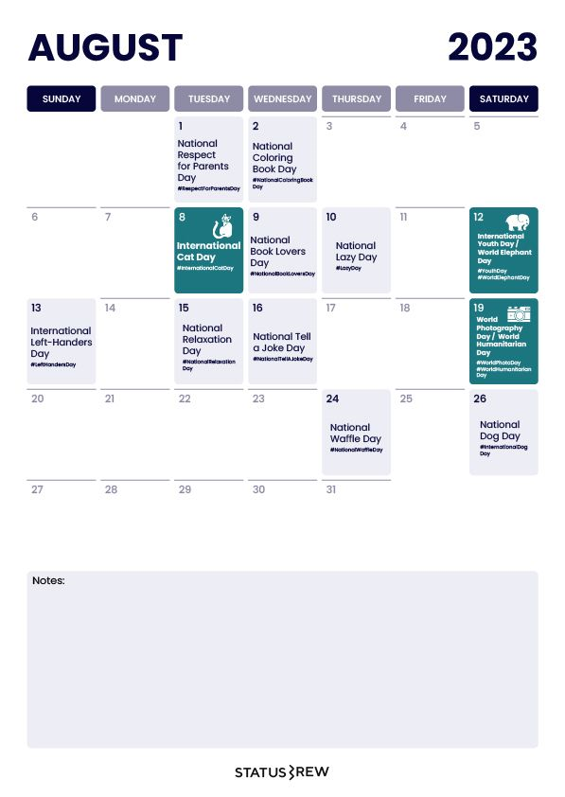
Part 3: Content Ideas and Marketing Strategies
Content Idea Generation & Strategy: Create a content calendar for the remaining month of July by brainstorming content themes, exploring various formats like blog posts, videos, infographics, podcasts, and interactive quizzes, and scheduling publication dates mainly on Facebook & Instagram.
And include the strategy, aim and the idea behind these posts and story
Content Calendar Example (Try creating a table for the month of July)

Slide 15
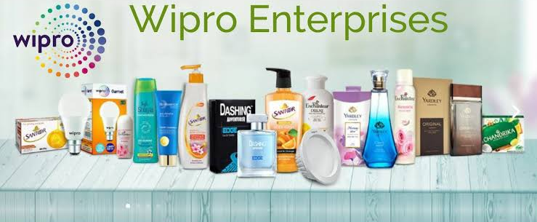
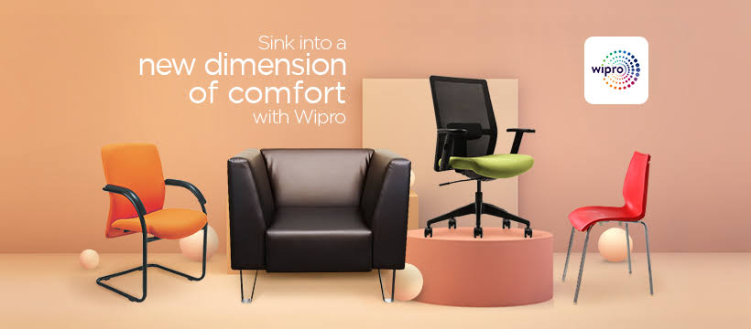
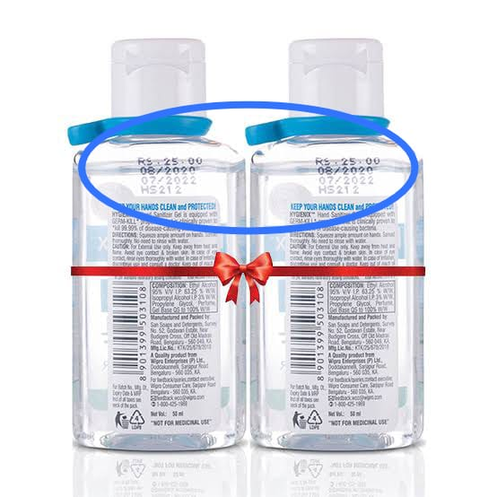
Part 3: Content Ideas and Marketing Strategies
Reflect on the content ideas and marketing strategies process, discussing the challenges encountered and lessons learned.
Date : 21/08/2023
Provide information about certain new products
I recommend visiting their official website or checking recent news and updates about their product launches.
Date : 22/08/2023
To promote newly launched products
Information about the newly launched products
This video visualised about different types of products on
Wipro
Date:23/08/2023
To Awareness on Expiry Dates
To create a meme on Expiry Dates

Slide 16
Creating content ideas and devising effective marketing strategies is a dynamic process that involves continuous learning and adaptation. Throughout this journey, several challenges and valuable lessons can be encountered. 1.Understanding the Audience: One of the primary challenges is comprehending the target audience's preferences, needs, and pain points. 2. Generating Unique Ideas: Coming up with fresh and innovative content ideas can be difficult, especially in saturated markets. 3. Consistency and Quality: Maintaining a consistent flow of high-quality content can be demanding. Setting up an editorial calendar and adhering to a content creation schedule helps in maintaining quality and meeting deadlines. 4. Content Promotion: Even the best content may not gain traction without proper promotion. Crafting effective marketing strategies to reach the target audience across various channels is crucial for success. 5. Collaboration: Collaborating with influencers or other brands can amplify the reach of content and strengthen marketing efforts. The content ideas and marketing strategies process is an iterative and learning-oriented journey

Slide 17
Part 4: Content Creation and Curation (Post creations, Designs/Video Editing, Ad Campaigns over Social Media and Email Ideation and Creation)
Post Creation:
Select Content Categories: Identify three different content formats relevant to the chosen topic or industry. Research and Brainstorm: Research trending topics, industry news, or audience interests within each category. Brainstorm ideas for social media posts that align with each category. Do note that 1 content format has to be video and additionally 3 stories/status are to be created.
Format 1: Blog Article
Format 2:Video
Format 3:Creative

Slide 18
Part 4: Content Creation and Curation (Post creations, Designs/Video Editing, Ad Campaigns over Social Media and Email Ideation and Creation)
Format 1:Blog Article
Aim : Provide information about certain new products
Date : 21/08/2023
Idea :I recommend visiting their official website or checking recent news and updates about their product launches.
Topic:
A Step by Step Guide To Information About Wipro
Step 1: Visit Wipro's Official Website : Go to Wipro's official website (www.wipro.com) to access the most recent and official information about their products and services.
Step 2: Navigate to the Products or Solutions Section : Look for the "Products" or "Solutions" section on Wipro's website. It might be listed under the main menu or within specific industry categories.

Slide 19
Step 3: Browse Recent Product Releases : Once you're in the products section, check for any subsection or page that highlights new product releases or updates. Companies often showcase their latest offerings on dedicated pages.
Step 4: Read Press Releases : Check the "News" or "Press Releases" section on Wipro's website. Companies often issue press releases to announce new products, partnerships, or significant achievements.
Step 5: Follow Wipro on Social Media : Follow Wipro on various social media platforms like Twitter, LinkedIn, and Facebook. Companies often share updates and announcements about their latest products on their social media channels.
Step 6: Monitor Technology News Websites : Keep an eye on technology news websites, business news platforms, and industry-specific publications. They often cover the latest product releases and updates from major companies like Wipro.
Step 7: Subscribe to Wipro's Newsletter : Subscribe to Wipro's newsletter if they offer one. Newsletters often contain updates on their latest products and services.
Step 8: Join Industry Forums and Discussions : Participate in industry forums and discussions where professionals may share information about recent developments in companies like Wipro.

Slide 20

Part 4: Content Creation and Curation (Post creations, Designs/Video Editing, Ad Campaigns over Social Media and Email Ideation and Creation)
Format 2: Video
Aim : To promote newly launched products
Date: 22/08/2023
Idea: Information about the newly launched products
Topic: This video visualised about different types of products on Wipro

Slide 21
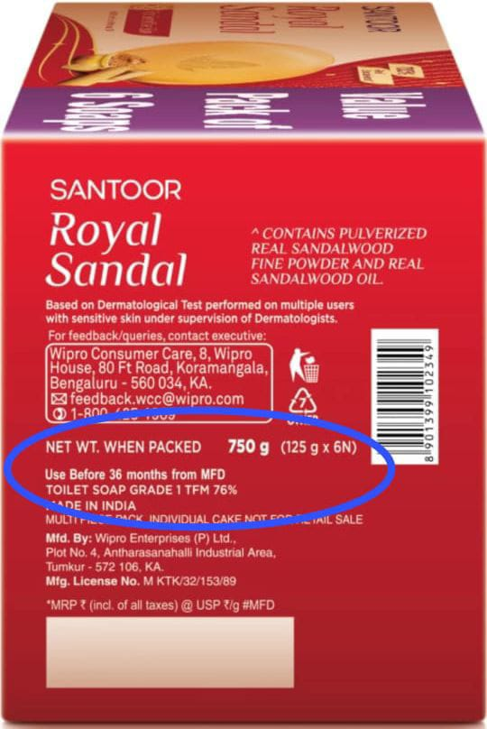
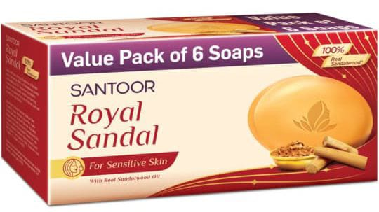
Part 4: Content Creation and Curation (Post creations, Designs/Video Editing, Ad Campaigns over Social Media and Email Ideation and Creation)
Format 3: Creative
Aim : To Awareness on Expiry Dates
Date:23/08/2023
Idea: To create a meme on Expiry Dates
Topic : Meme

Slide 22
Part 4: Content Creation and Curation (Post creations, Designs/Video Editing, Ad Campaigns over Social Media and Email Ideation and Creation)
Instagram Story
Utilize the Stories feature on Instagram for three consecutive days. Share behind-the-scenes glimpses, polls, quizzes, or sneak peeks etc to encourage audience participation. Once uploaded use the story highlight feature on Instagram and save the 3 story with an appropriate name for each.
Note:
Once done monitor the performance of the posts and Stories using the insight tool and analyze the engagement metrics (likes, comments, shares, impressions, etc.). Based on the analysis, mention the strategies and areas for improvement.

Slide 23
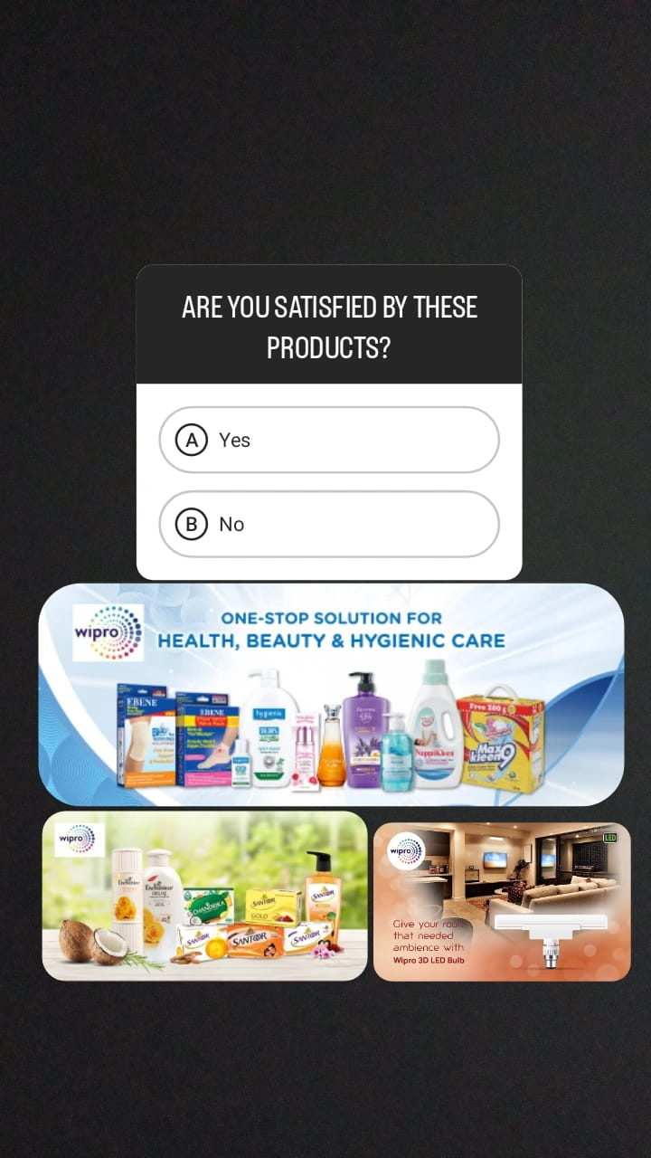
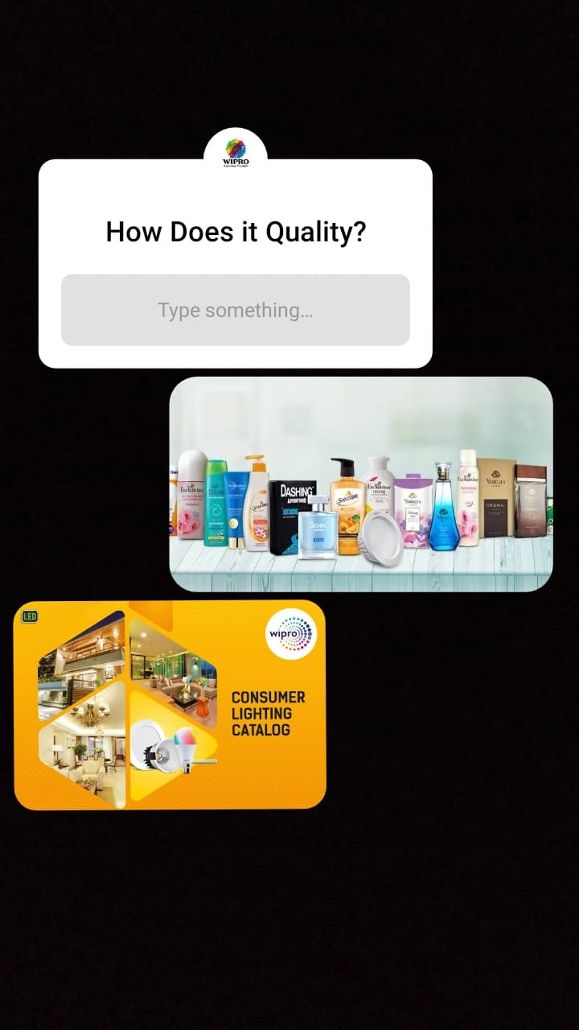

Part 4: Content Creation and Curation (Post creations, Designs/Video Editing, Ad Campaigns over Social Media and Email Ideation and Creation)
Instagram Story

Slide 24
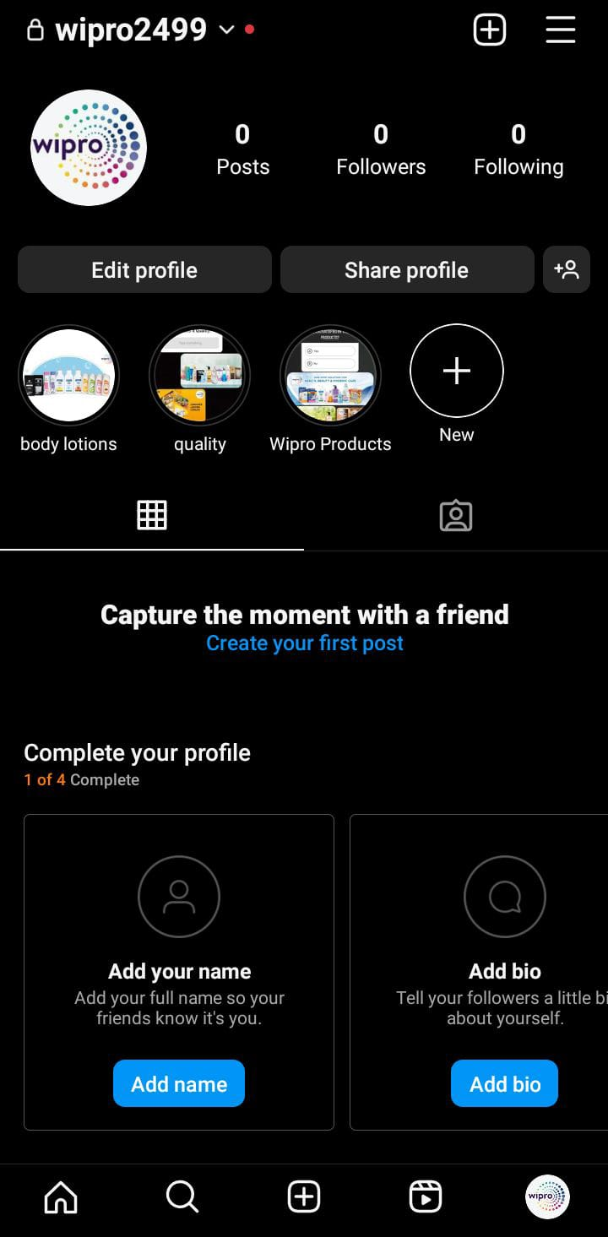

Slide 25
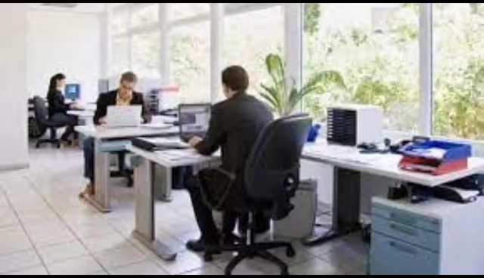
Part 4: Content Creation and Curation (Post creations, Designs/Video Editing, Ad Campaigns over Social Media and Email Ideation and Creation)
Designs/Video Editing
Design Tools Familiarization (use Canva for creating visually appealing graphics)
Video Creation: Utilize VN or any video editor of your choice to create videos related to the chosen topic.

Slide 26
Part 4: Content Creation and Curation (Post creations, Designs/Video Editing, Ad Campaigns over Social Media and Email Ideation and Creation)
Social Media Ad Campaigns
Ad Campaigns over Social Media:
Come up with 3 ad campaigns each covering one of the mentioned goals: brand awareness, driving website traffic, or generating leads

Slide 27
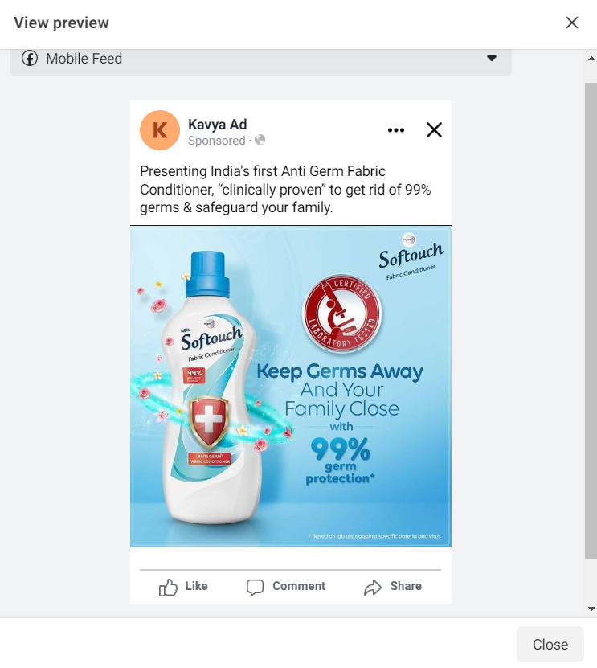
Brand Awareness :
TARGETING: Location : India, All Gender,
Age , Interest : TCS , INFOSYS.

Slide 28
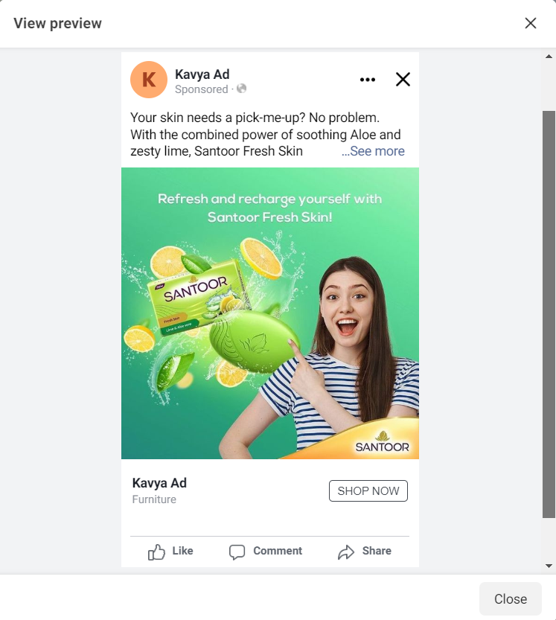
Driving Website Traffic:
TARGETING: Location : India, All Gender,
Age , Interest : TCS , INFOSYS.

Slide 29
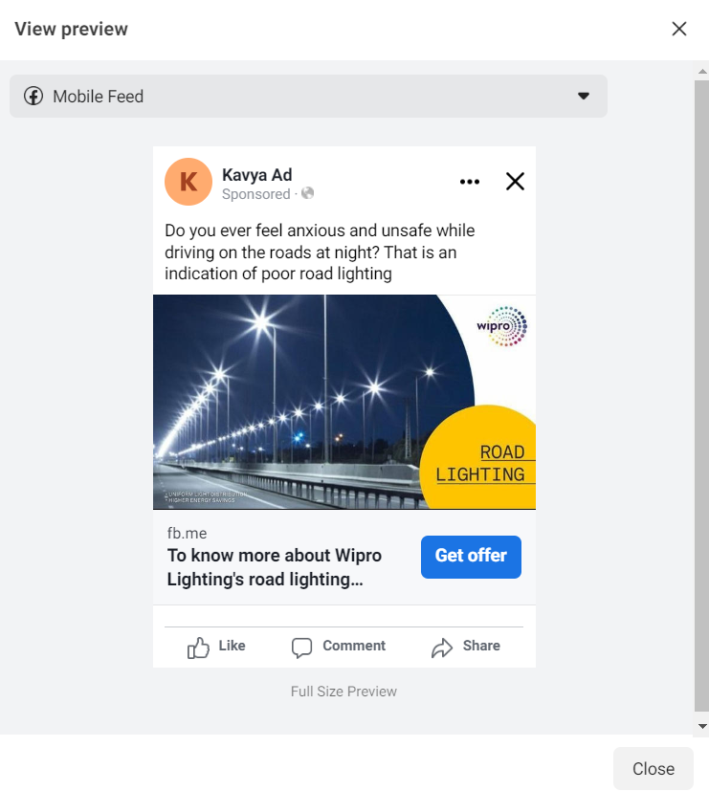
Generating leads
TARGETING: Location : India, All Gender,
Age , Interest : TCS , INFOSYS

Slide 30
Part 4: Content Creation and Curation (Post creations, Designs/Video Editing, Ad Campaigns over Social Media and Email Ideation and Creation)
For every campaign clearly define:
Advertising Goals: increasing brand awareness, driving website traffic, or generating leads.
Audience Targeting: Define the target audience for the ad campaigns based on demographics, interests, and behavior.
Ad Creation: Create visually appealing ad creatives, compelling ad copy and relevant call-to-action.

Slide 31
Part 4: Content Creation and Curation (Post creations, Designs/Video Editing, Ad Campaigns over Social Media and Email Ideation and Creation)
Email Ad Campaigns
Ad Campaigns for email marketing:
Come up with 2 email ad campaigns with the mentioned goals: brand awareness & generating leads

Slide 32
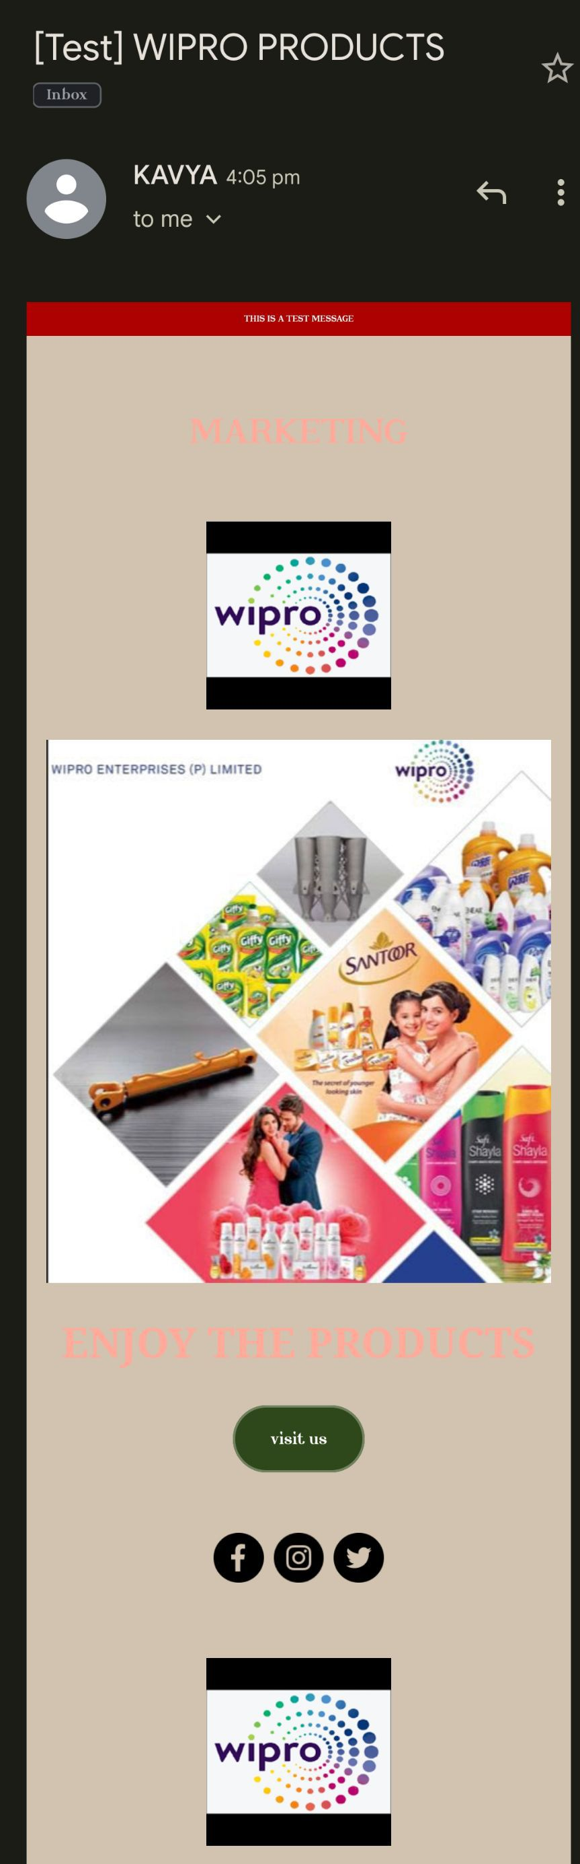
Email Ad Campaign 1 - Brand Awareness

Slide 33
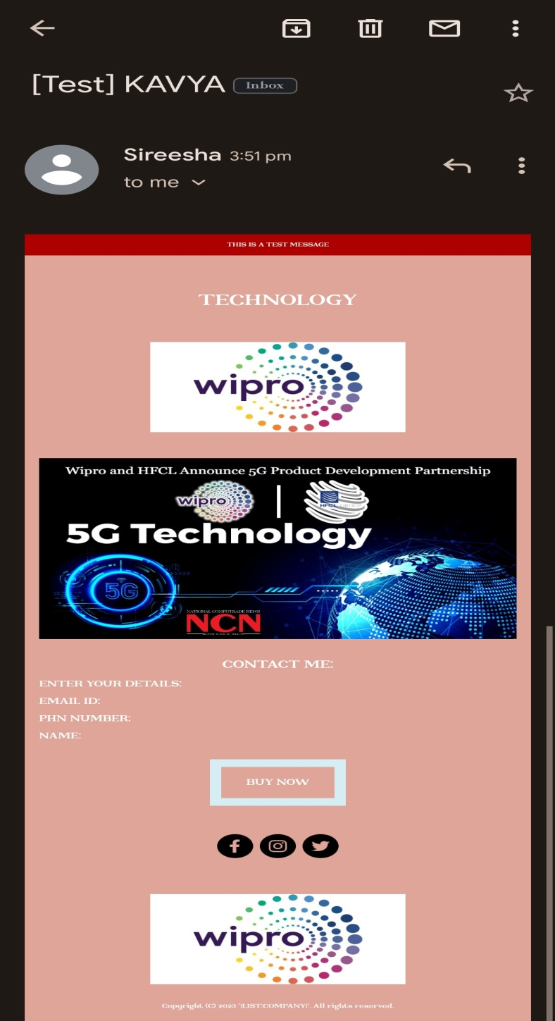
Email Ad Campaign 2 - Lead Generation
(insert emailer image)

Slide 34
Part 4: Content Creation and Curation (Post creations, Designs/Video Editing, Ad Campaigns over Social Media and Email Ideation and Creation)
Reflect on the content creation and curation process, discussing the challenges faced and lessons learned.
1. Consistency is Key: Maintaining a consistent tone, style, and frequency of content across platforms helps reinforce brand identity and improves audience recall.
2.Visual Appeal: Eye-catching visuals, well-designed graphics, and professionally edited videos can significantly enhance the impact of content and ad campaigns.
3. A/B Testing: Regularly conducting A/B + tests for ad campaigns and email subject lines allows for data-driven optimization and better results.
4.Know our Audience: Understanding the target audience's interests, pain points, and preferences is fundamental in creating relevant and engaging content.
5. Engage with the Audience: Responding to comments, messages, and feedback from the audience fosters a sense of community and builds trust.
6. Long-Term Approach: Content creation and marketing are not one-time endeavors. A long-term, strategic approach is necessary to build brand awareness and achieve sustainable growth.
In conclusion, content creation and curation, along with thoughtful design, video editing, and well-executed ad campaigns, play a pivotal role in a successful marketing strategy. By understanding the challenges and incorporating the lessons learned, businesses can create compelling content that resonates with their target audience and drives results

